Slide 1

#>_ Population Genomic Analysis of Lactose Intolerance
$> Project Proposal
$> Post-Genomics Analysis
$> Fall 2025
#> Randhal Ramirez
#> Jaime Gutierrez

Slide 2
#PG>_ Objective
$> cat objective_main_questions.txt
Since different human populations have different needs and dietary requirements, which populations are more susceptible to develop lactose intolerance?
Sq:> Can the lactose intolerance be reversed?
Sq:> Which specific variants of the genes causes the condition?

Slide 3
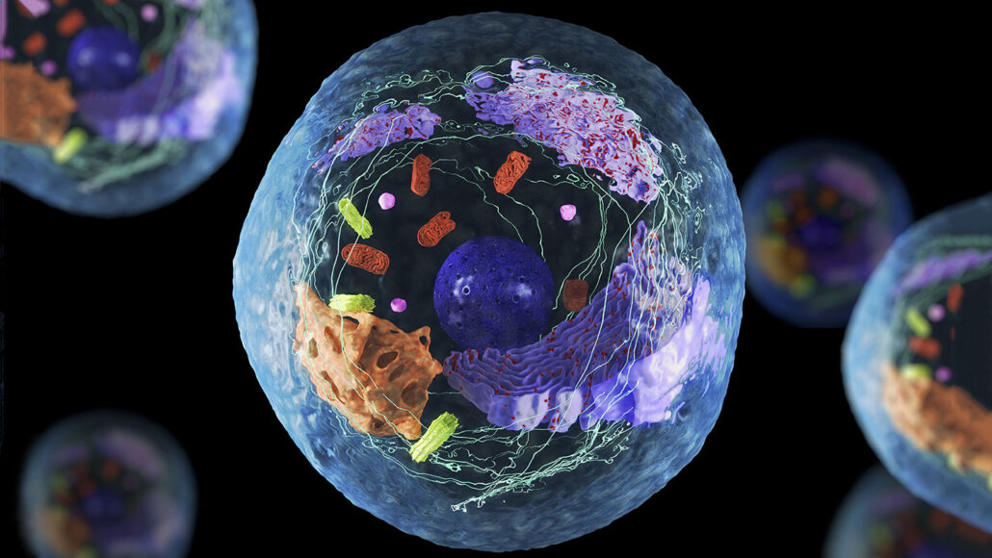
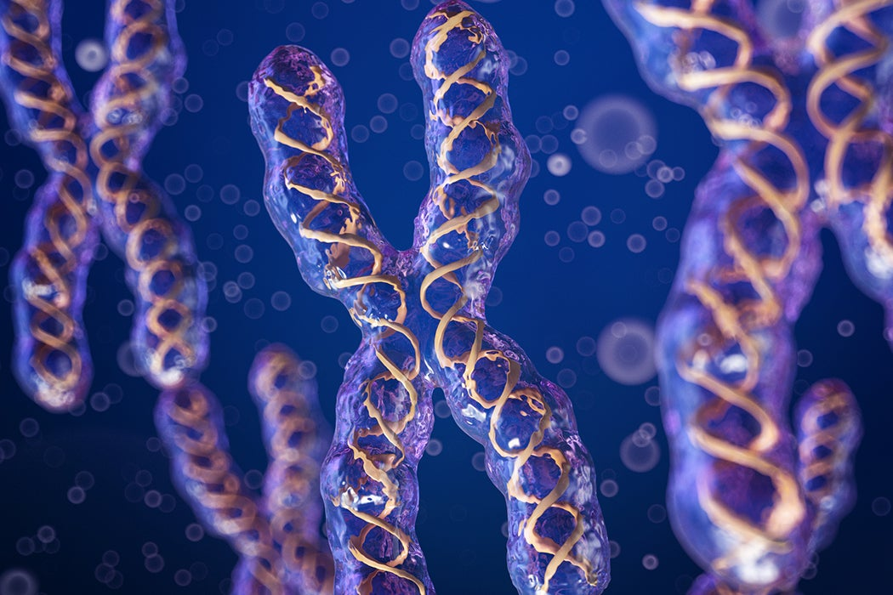
#PG>_ Overview
$> cat describe.txt
Cells are the building blocks of life. Inside the human cell's nucleus, 23 pairs of chromosomes hold the DNA blueprint. This genetic code defines an individual's unique traits, like the ability to digest lactose located in chromosome 2.

Slide 4
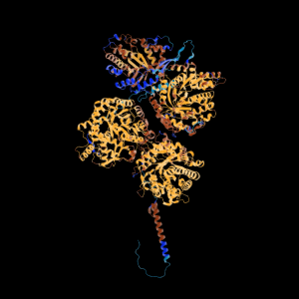
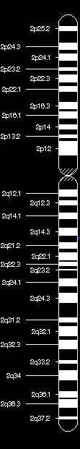
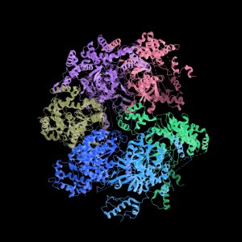
#PG>_ Overview
Gene: LCT
$> cat describe_genes.txt
The main genes that control the lactose intolerance are the genes LCT and *MCM6, located in chromosome 2. LCT, located in the band 2q21.3, gene is the one directly related to the production of the enzyme lactase, in the other hand MCM6, located in the band 2q21.3, is the gene that regulate the expression of the gene LCT.
Micro Chromosome Maintenance (MCM) Genes are genes fundamental in DNA replication.
Gene: MCM6

Slide 5
#PG>_ Data
$> cat sources.txt
We’ve got datasets from:
Thousand genomes project (2504 individuals) (https://www.internationalgenome.org/)
Gnomad (~800k individuals)
https://gnomad.broadinstitute.org/

Slide 6
#PG>_ Overview
$> cat describe_variants.txt
Some people are born completely lactose intolerant; this very strange condition is caused by several mutations directly in the LCT. Those variants include: Y1390X (Yami), S1666fsX1722 (Steve) or G1363S (Gabriel)
The most common type of lactose intolerance is caused by the downregulation of the LCT gene caused by MCM6. those include: rs4988235 (European), rs41380347 (Middle east).

Slide 7
#PG>_ Data <Variant Identification>
$> cat MCM6.variants
# | Variant / rsID | Absolute Position (b37) | Population | Frequency
1 | rs4988235 | 2:136608646 | European (Main) | 24 %
2 | rs182549 | 2:136616754 | European (Backup) | 24 %
3 | rs41525747 | 2:136608643 | North African | <0.1%
4 | rs4988233 | 2:136608645 | Ethiopian | <0.1%
5 | rs41456145 | 2:136608649 | Cameroonian | <0.1%
6 | rs41380347 | 2:136608651 | Middle Eastern | 0.2 %
7 | rs869051967 | 2:136608745 | East African | <0.1%
8 | rs145946881 | 2136608746 | East African (Main) | 0.3 %
9 | rs55660827 | 2:136598443 | Rare Coding Variant | 19 %

Slide 8
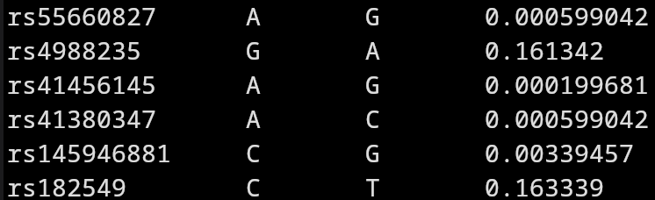
#PG>_ Data <Analysis example>
$> bcftools query variants MCM6_annotated.vcf.gz
Note: The Backup and the main mutation for the European Lactose Tolerance variant is most of the time in existence with the main variant.
Note: The existence of several mutations that allows the digestion of lactose is an example of convergent evolution.

Slide 9

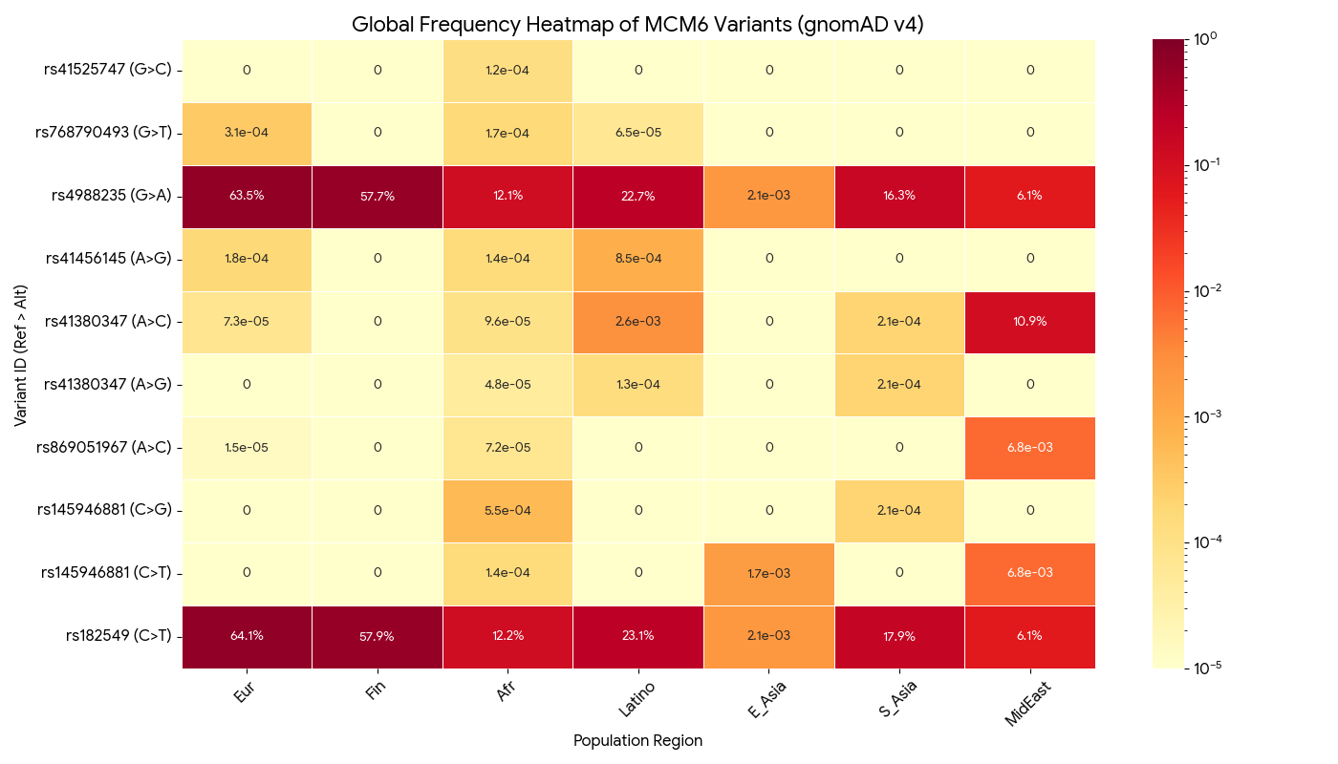
#PG>_ Analysis
() $py_env> ./preliminary_results.py

Slide 10
#PG>_ Data <Variant Identification>
$> cat LCT.variants: 1/60000 in findland newborns ~100 in World's History.
# | Variant / Name | rsID | Absolute Position (b37) | Type | Freq
1 | Y1390X (FinMajor) | rs121908936 | 2:136564701 | Nonsense | < 0.001%
2 | S1666fsX1722 | rs386833836 | 2:136552321 | Frameshift | < 0.001%
3 | G1363S (Turkey, Iraq, Fin) | rs386833833 | 2:136564784 | Missense | < 0.001%
4 | S218F | rs121908937 | 2:136552274 | Missense | < 0.001%
5 | Q268X | rs121908938 | 2:136552424 | Nonsense | < 0.001%
6 | FinMinor | rs80338959 | 2:136587428 | Frameshift | < 0.001%
7 | L1313del | rs796052187 | 2:136565147 | Deletion | < 0.001%
8 | Q1447X | rs1416973347 | 2:136563636 | Nonsense | < 0.001%
NOTE: All of these variants refer to populations in Finland. Why Findland? Because of the founder effect and other fact.
https://www.researchgate.net/publication/7370495_Mutations_in_the_Translated_Region_of_the_Lactase_Gene_LCT_Underlie_Congenital_Lactase_Deficiency

Slide 11
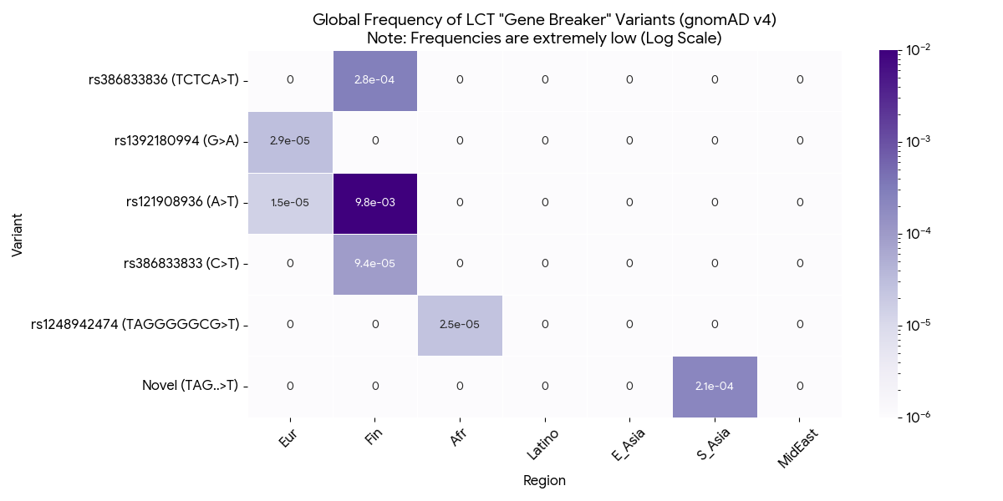
#PG>_ Data <Analysis example>
$> ./03-view-significant-variants-LCT.sh
LCT 136513445 T <CN2> 0.000199681
$> ./02-compute_LCT_breakers.sh

Slide 12
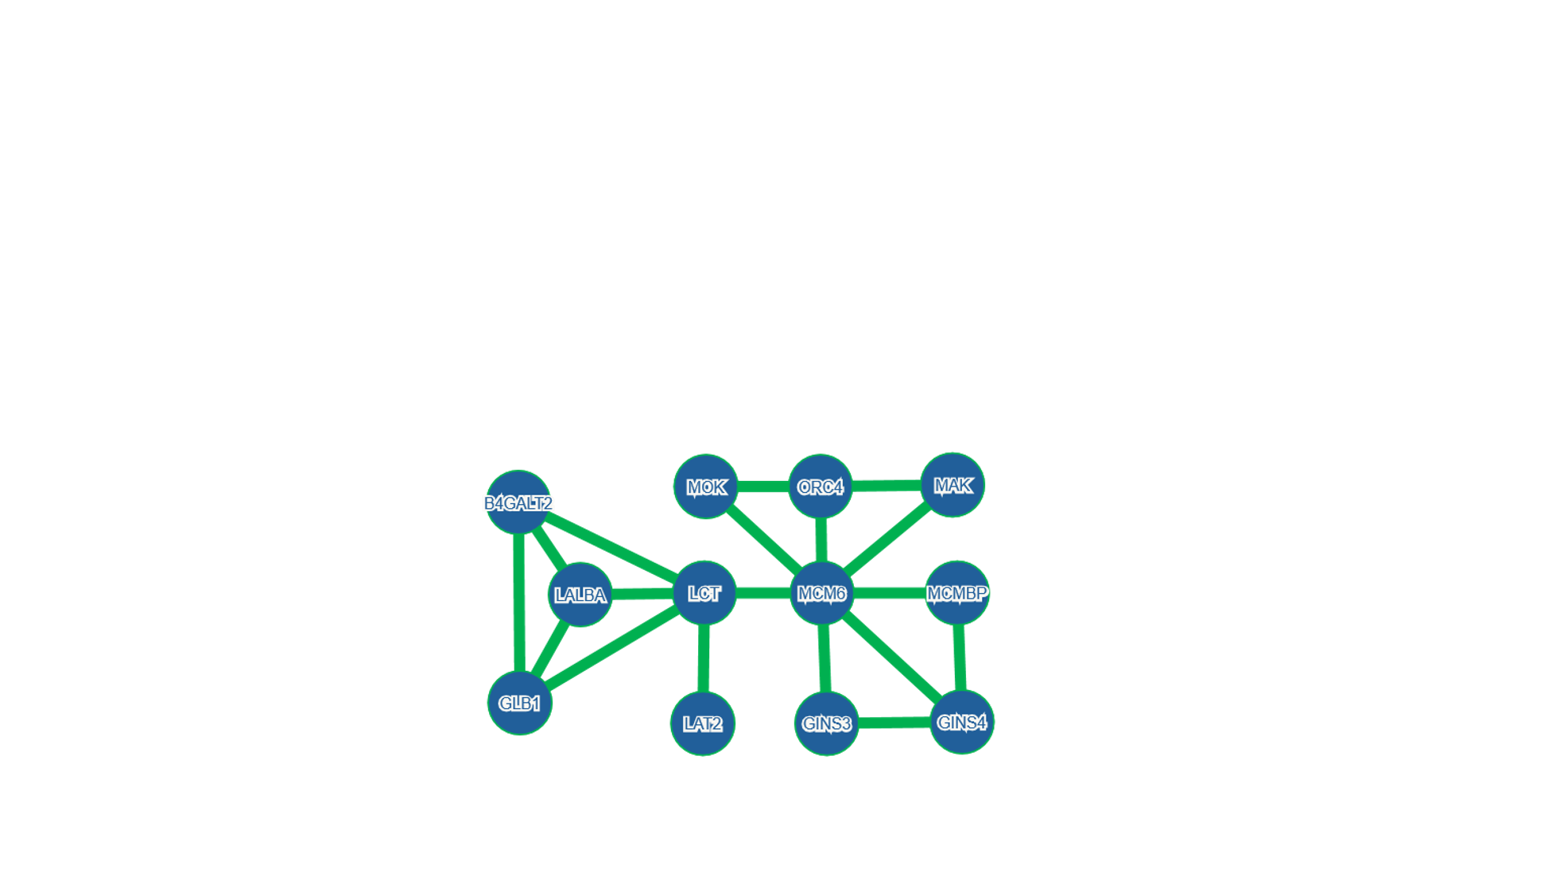
#PG>_ Data <Other genes>
$> print Other_genes.

Slide 13
#PG>_ Data <Other genes>
$> cat Other_genes.
Gene | Function | Relationship to Lactose Intolerance
LALBA | Alpha-lactalbumin. Forms the Lactose Synthase complex in the breast. | The "Producer." It determines if milk contains lactose. If mutated, the mother cannot produce milk. It does not affect digestion.
B4GALT2 | Beta-1,4-galactosyltransferase 2. Builds sugar chains (oligosaccharides). | The "Cousin." It is chemically similar to the enzyme that makes lactose, but it is not involved in digestion.
GLB1 | Beta-Galactosidase. Breaks down sugars in the lysosome (cell waste disposal). | The "Backup" (that doesn't help). It performs the exact same chemical reaction as LCT but works inside cells, not in the gut. Mutations cause GM1 Gangliosidosis, not intolerance.
MCMBP | MCM Binding Protein. Transports MCM proteins into the nucleus. | MCM6 Protein Partner. Essential for DNA replication. No interaction with the "Milk Switch" in the intron.
ORC4 | Origin Recognition Complex. Finds start sites for DNA copying. | MCM6 Loader. It loads the MCM6 protein onto DNA to start replication. Irrelevant to digestion.
GINS3 | GINS Complex Subunit 3. Part of the DNA helicase motor. | MCM6 Engine Part. Locks onto MCM6 to help unzip DNA. Irrelevant to digestion.
GINS4 | GINS Complex Subunit 4. Part of the DNA helicase motor. | MCM6 Engine Part. Same as above; functional partner of the MCM6 protein.
MAK | Male Germ Cell Associated Kinase. Regulates cilia and cell cycle. | Cell Cycle Network. Co-expressed with replication genes. No link to digestion.
MOK | MAPK/MAK/MRK Overlapping Kinase. Kinase involved in cell regulation. | Cell Cycle Network. Likely appears in your list because it interacts with the machinery MCM6 is part of.
LAT2 | Linker for Activation of T Cells 2 (or Amino Acid Transporter). | Unrelated. Likely appears due to extremely rare conditions.

Slide 14
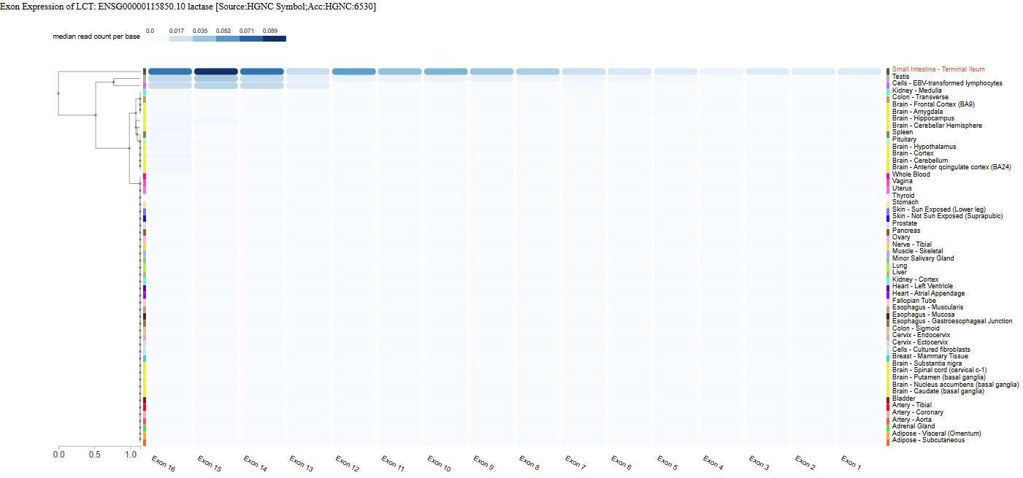
#PG>_
LCT Tissue Specificity using GTEx
Notes:
Analyzed transcriptomic data from the GTEx (Genotype-Tissue Expression) project to confirm that LCT expression is highly specific to the Small Intestine (Terminal Ileum)

Slide 15
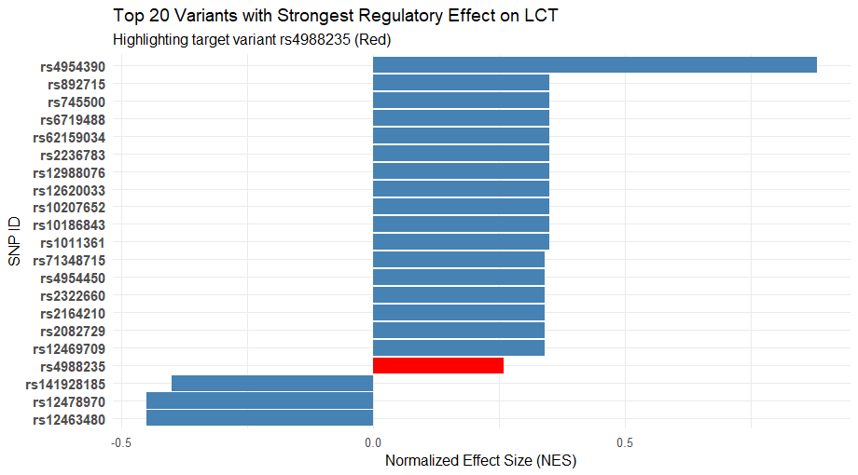
#PG>_ Fine Mapping using R
() $py_env> ./variants_results.r
Notes:
The European persistence variant, rs4988235 (highlighted in Red), shows a significant positive effect (NES > 0).
This confirms it acts as an enhancer (increases expression).
Linkage Disequilibrium (LD): The variant clusters with others (like rs4954390) that show similar statistical signals because they are inherited together in the same haplotype block

Slide 16
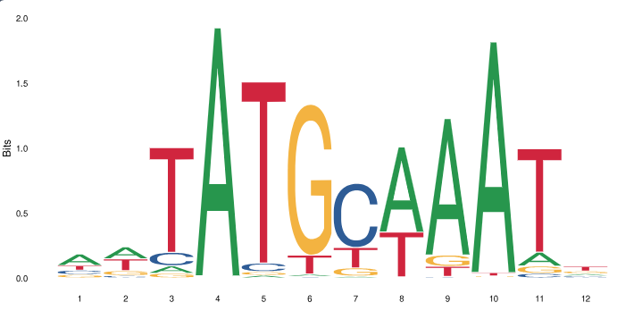
#PG>_Molecular Mechanism using Motif Finding (MEME)
Downloaded the DNA sequence surrounding rs4988235 (+/-20bp) from the UCSC Genome Browser
Found 3 distinct motifs, but analyzed the upstream transcription factor motif using JASPAR
The derived "T" allele (Lactase Persistence) creates a new binding site for the transcription factor Oct-1 (POU2F1), so the mutation creates a landing pad for Oct-1, which drives the upregulation of LCT in adulthood

Slide 17
#PG>_ Is it reversible?
> DNA methylation is involved in downregulating the LCT gene and lactase production (Labrie et al.). No matter how much milk you ingest, if you have the reference allele you will become lactose intolerant eventually.
> CRISPR & gene editing is theoretically possible but editing for a non-fatal condition like this is essentially unethical and illegal currently.
> Viral gene therapy involves using a viral vector (like AAV) to deliver a functional copy of the lactase gene into your intestinal cells, but it remains experimental and unapproved.

